Slide 1
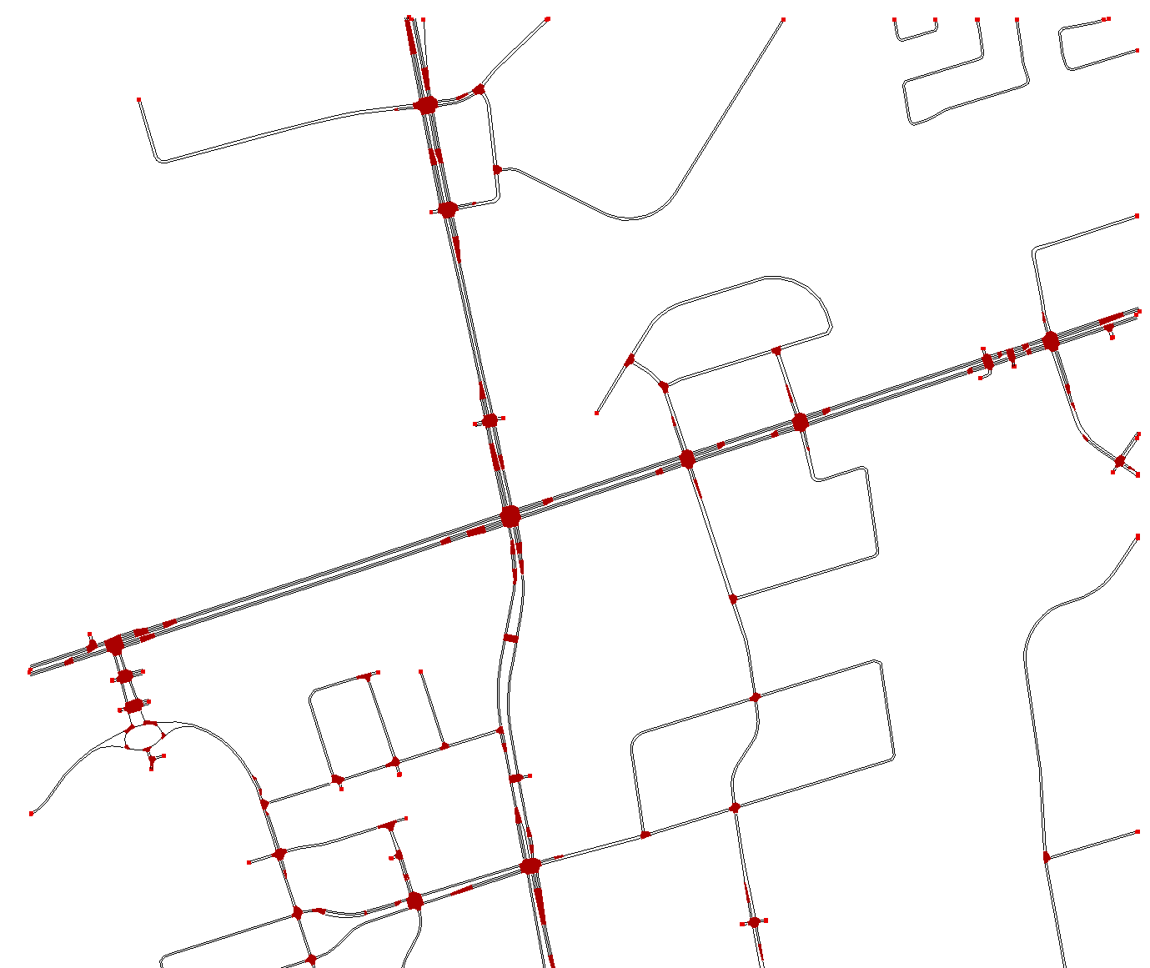
Detailed Instruction for Group 2: Intersection of Interest
Your Intersection of Interest is this (Orange Circle)
Traffic flow demands need to be begun from the blue circles in each approach
Intersection of Interest
Traffic Flow Beginning point

Slide 2
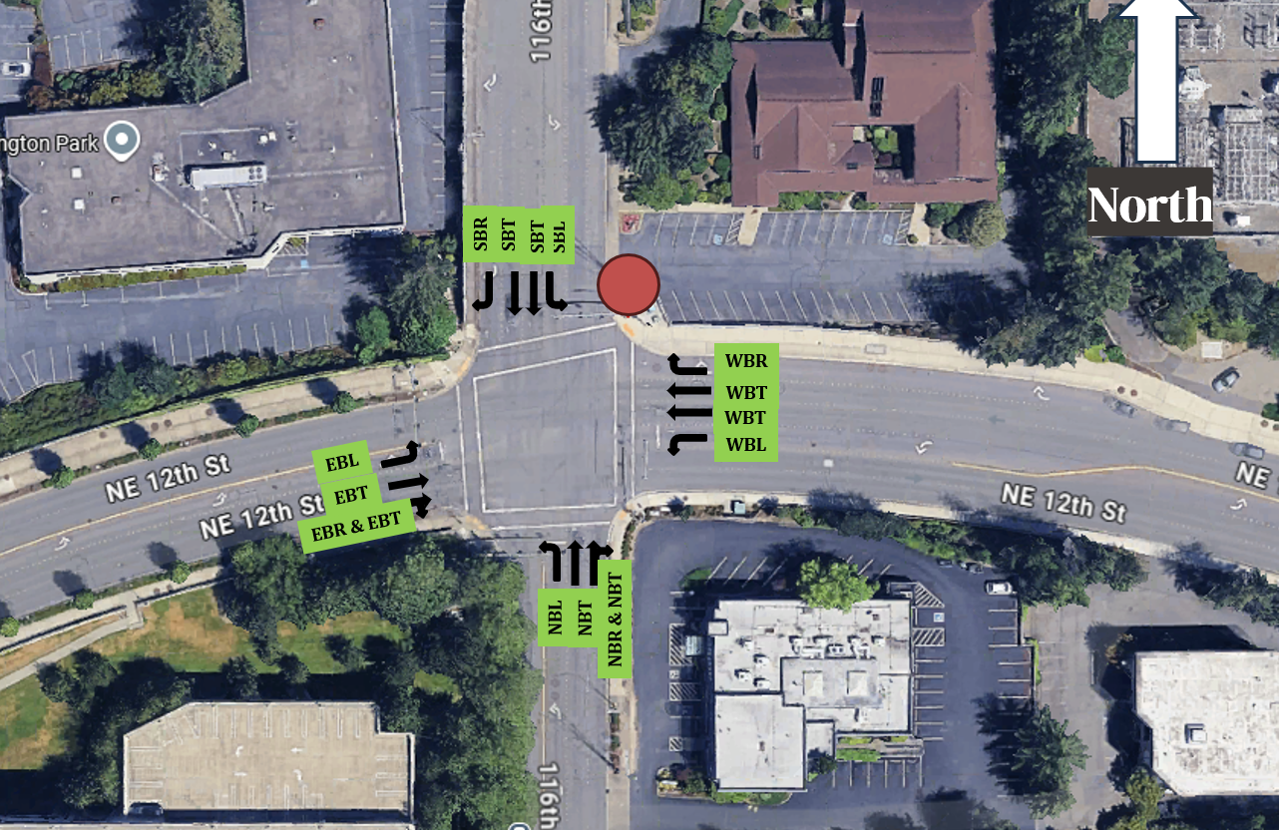
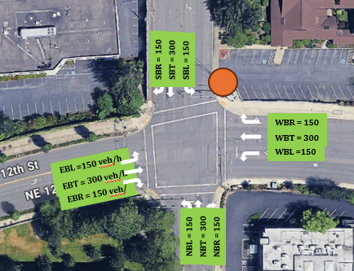
Traffic Flow
The traffic flow for each movement is equal distribution of 150 veh/h
Assume below, the traffic volume would be (do this step carefully using your intersection)
Below is just an example

Slide 3
Traffic Signal
Traffic Signal: Consider the same traffic signal phases and duration as Lab 2 for your intersection of interest

Slide 4
Sample Figures for Report A
Please use this PowerPoint as a template for preparing your figures for the report
These figures need to be imported in the word file (report A)
Please develop your own figures based on the analysis and replace those with these (these are samples)

Slide 5
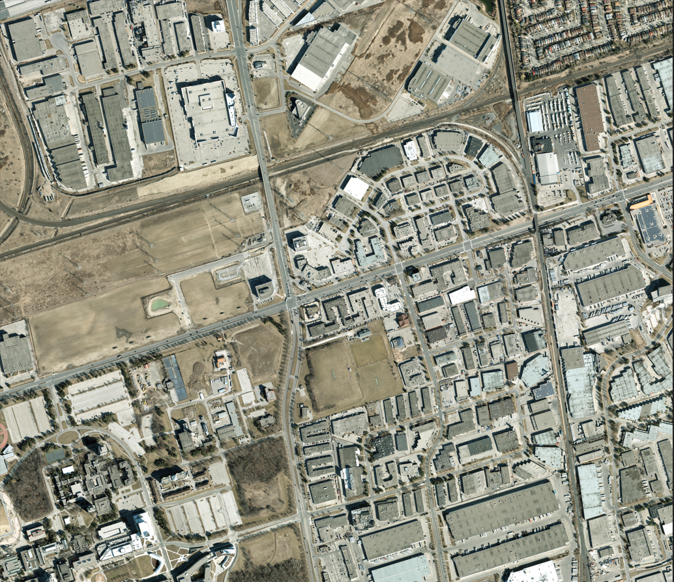
Figure1. Study Area GIS Map

Slide 6
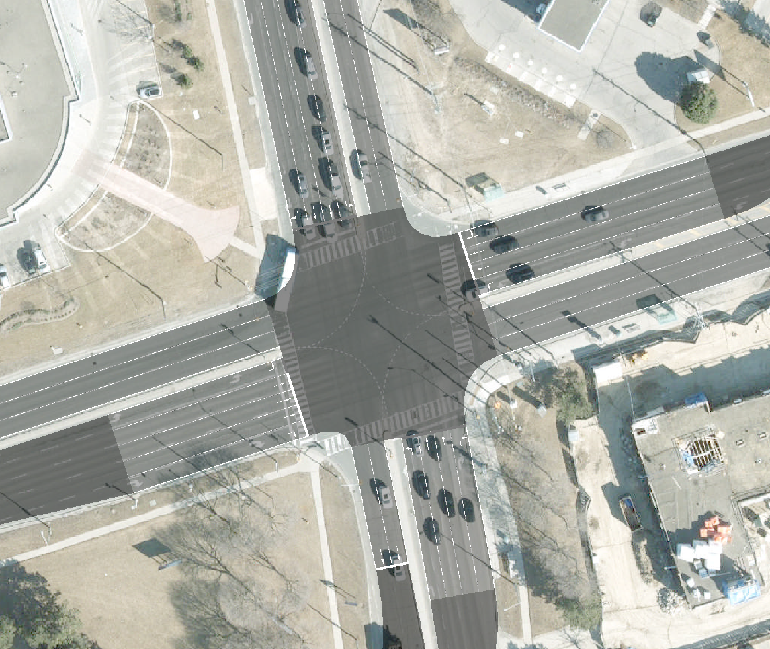
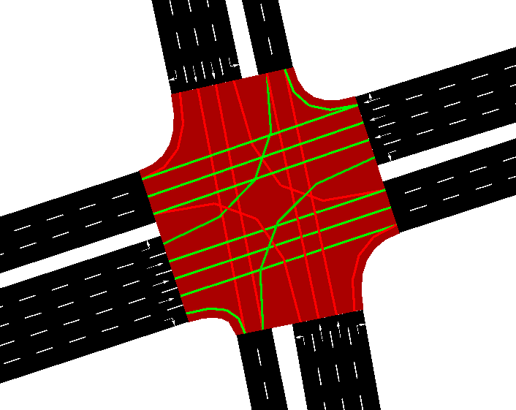


Methodology
a) SUMO Network -100% HDV
b) SUMO Network -100% CAV
c) Intervention (Traffic Signal)
Intervention Selection (See Lab 02 PowerPoint)
Choose ONE of the three intervention options. The intervention must directly affect the same street selected for your speed–density analysis.
Lane Modification: Add or remove a lane on the selected street.
Traffic Signal Timing: Modify the signal phases controlling traffic on the selected street.
Traffic Flow Adjustment: Modify the traffic demand affecting the selected street.
Figure2. Methodology

Slide 7
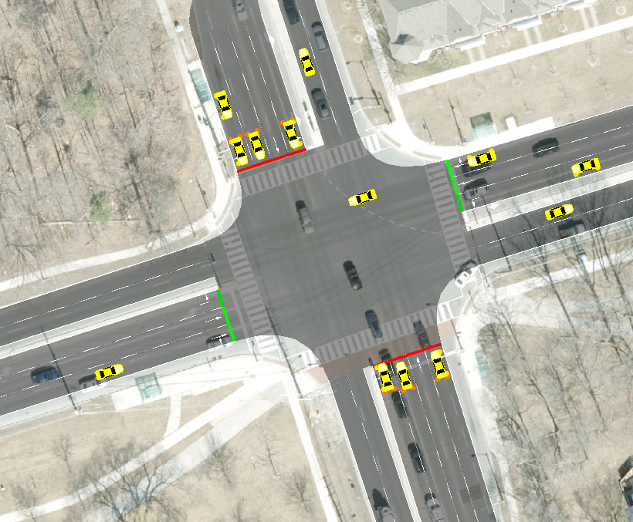
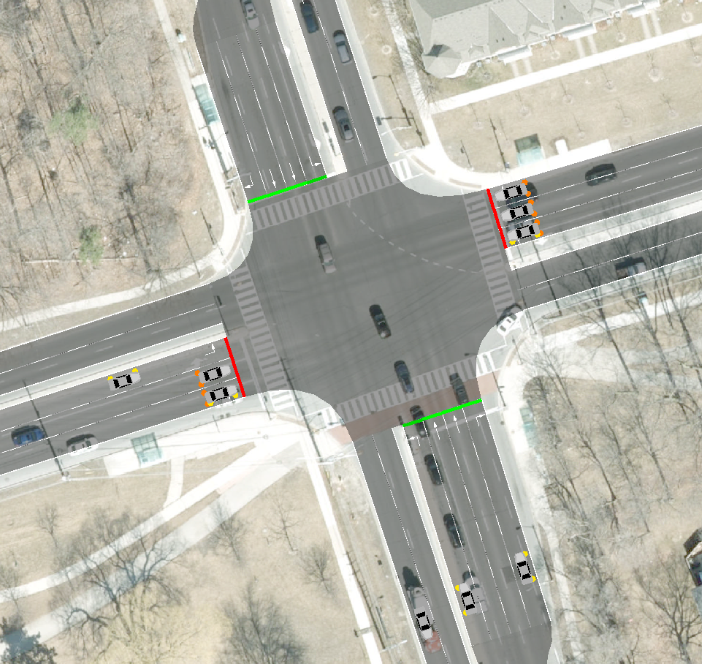
Add Your Figures
??
??
a) Challenge 1
b) Challenge 2
Figure3. Road Network Development Challenges

Slide 8
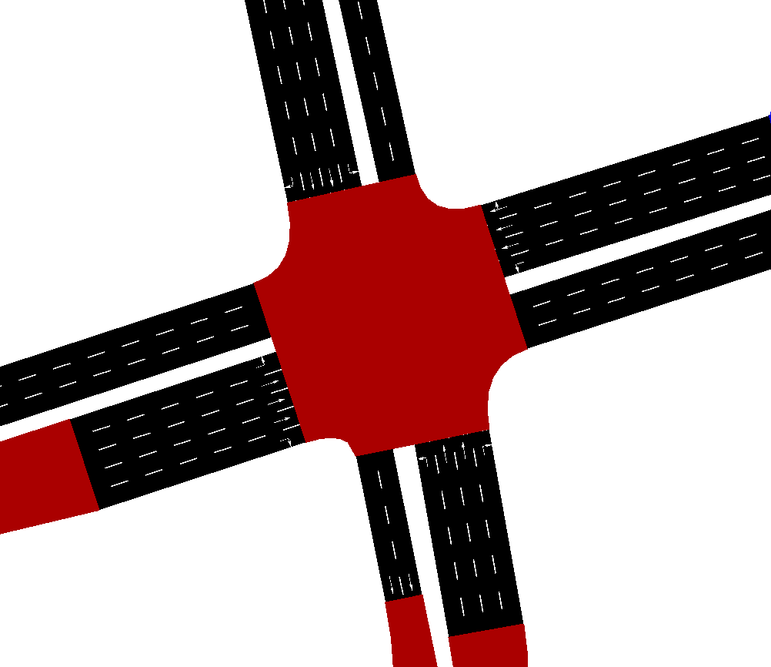
These are sample Images – You may develop your own images –
you may choose another street
Intersection of Interest
Traffic Flow Beginning point
Road: E 78
Add Name
Figure 4. Developed SUMO Network for Intersection X-Y

Slide 9
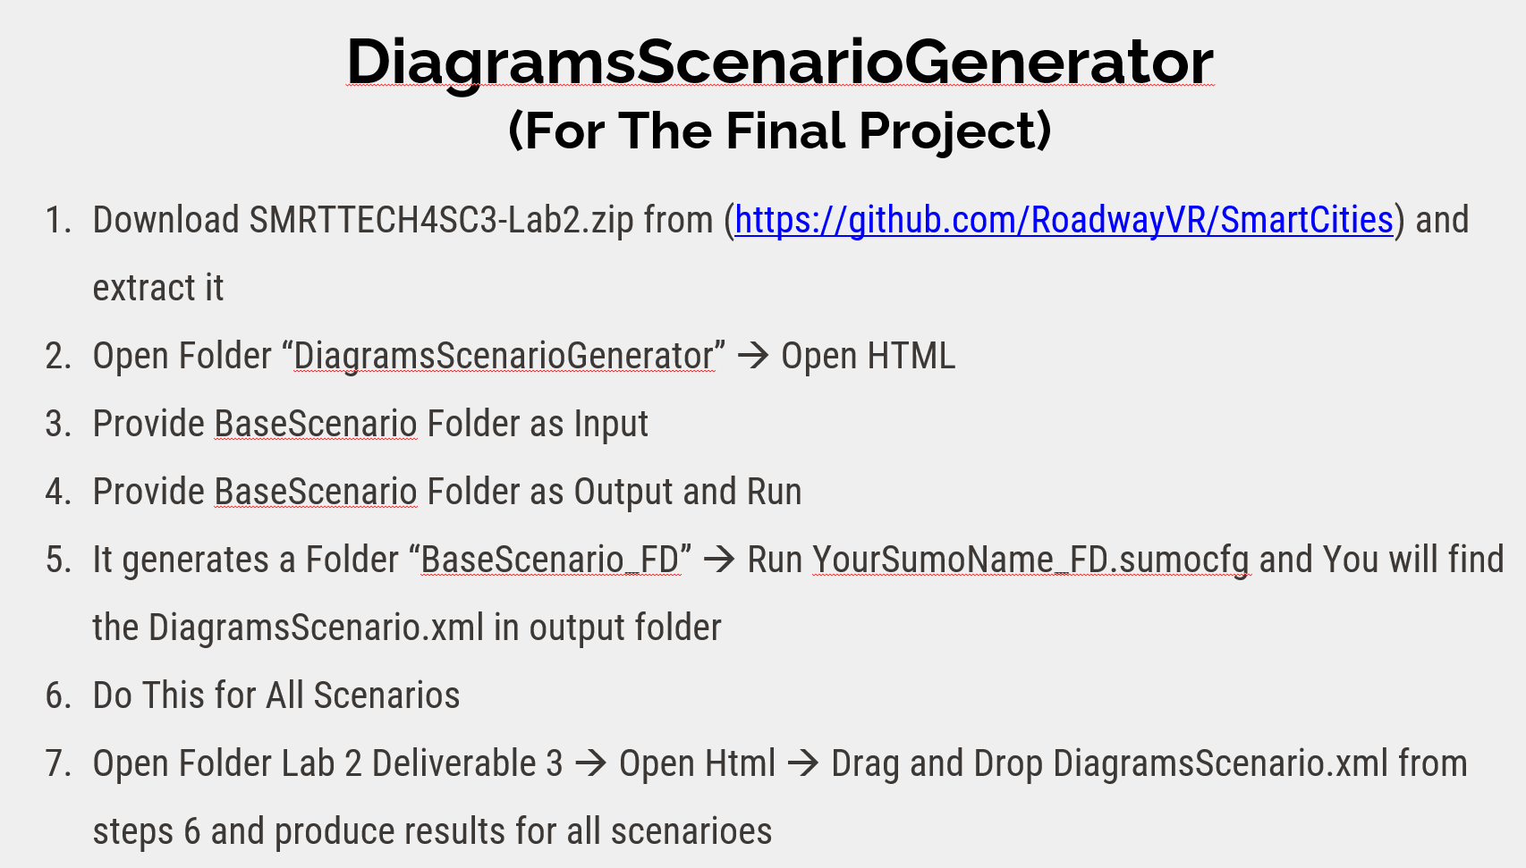
Important: To Generate Figures 5 and 6, please observe the last slide of Lab 2
This gives you easier workflow to generate DiagramsScenario.xml in different scenarioes

Slide 10
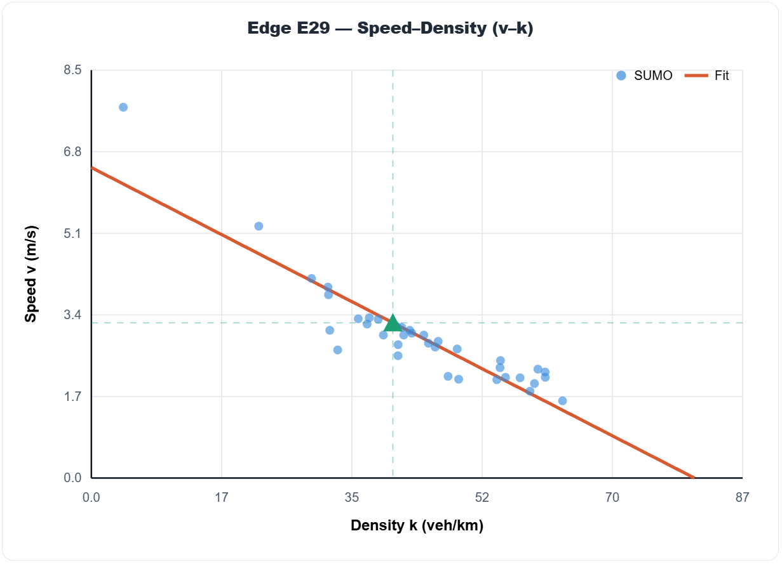
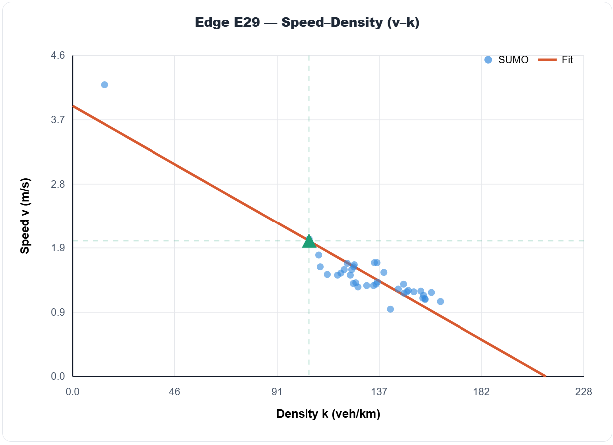
These are sample Images
Base Scenario
Scenario 1
Figure 5. Results

Slide 11
These are sample Images
Base Scenario (Same Figure as Previous Slide)
Scenario 2
?
Figure 6. Results

Slide 12
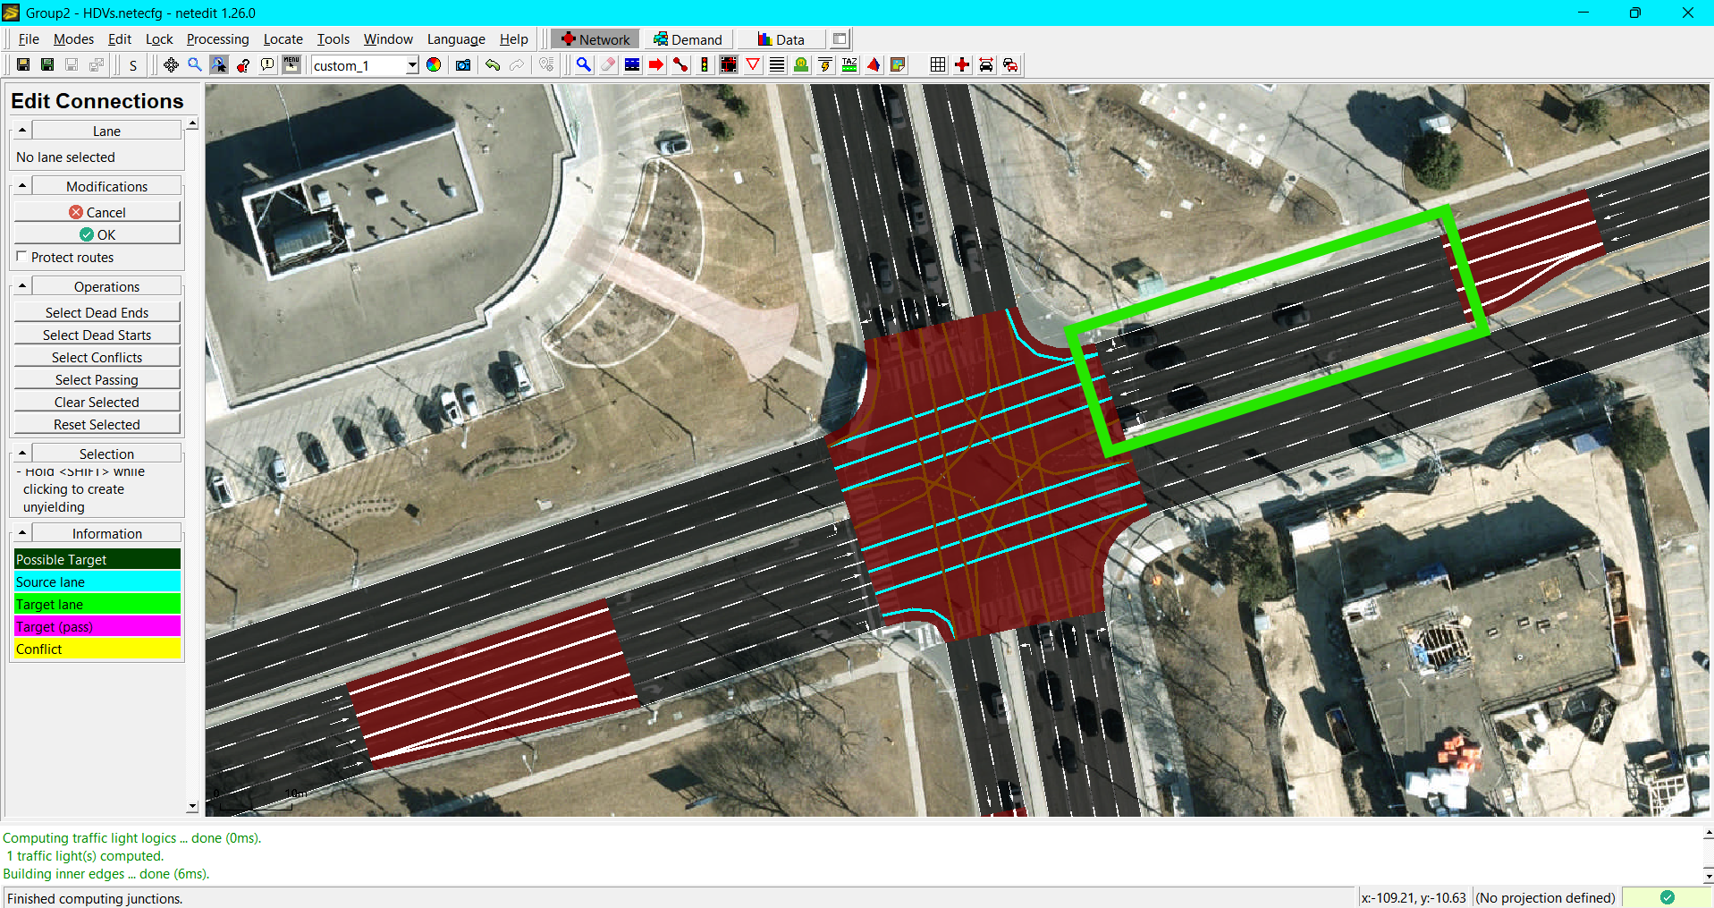
Selected Edge: E80

Slide 13
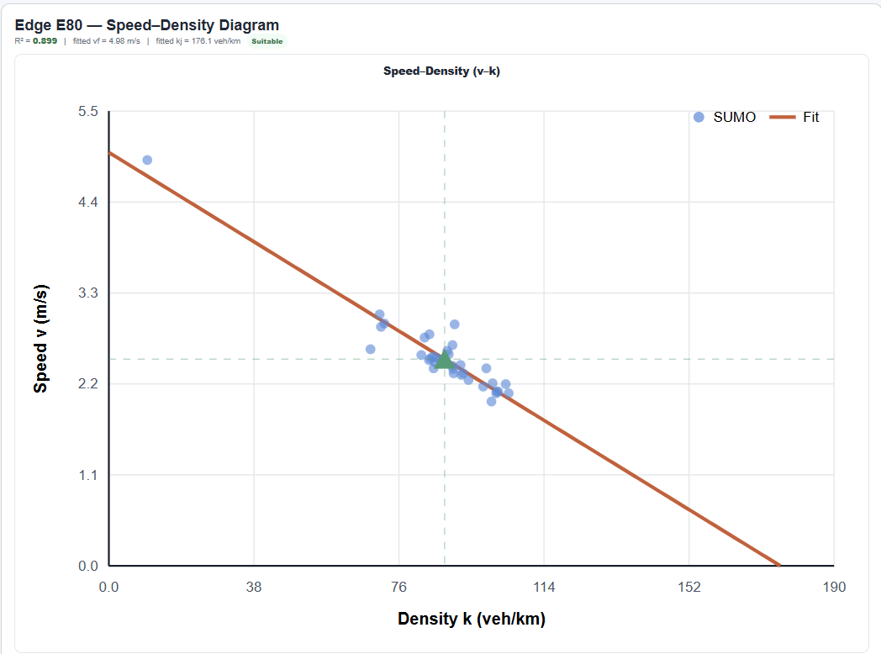
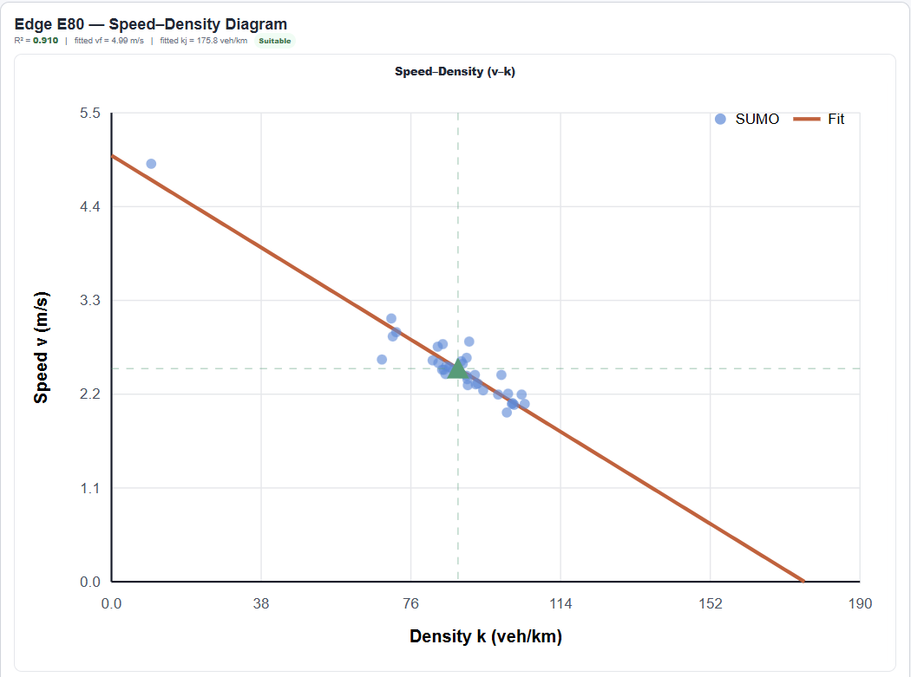
Base Scenario (HDV) vs. Scenario 1 (CAV)
Base Scenario (HDV)
Scenario 1 (CAV)

Slide 14
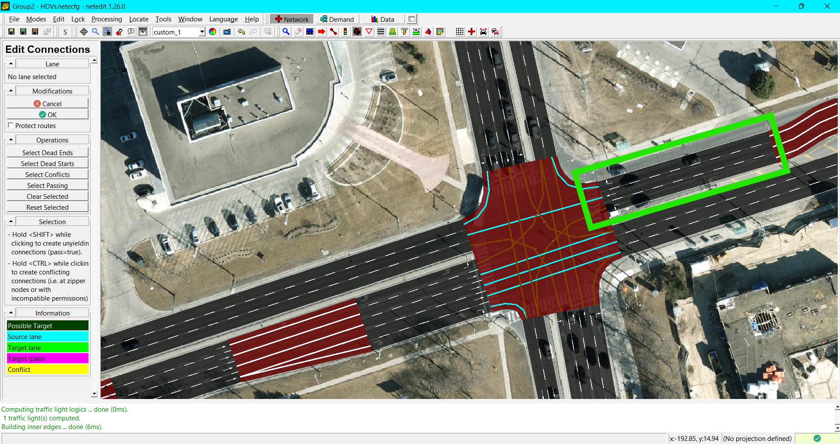
Base Scenario (HDV) vs. Scenario 2 (HDV, Intervention)
Selected intervention: removal of a WBT lane
*Note: the traffic demand for WBT was kept the same (450 veh/hour), only the number of through lanes was reduced

Slide 15
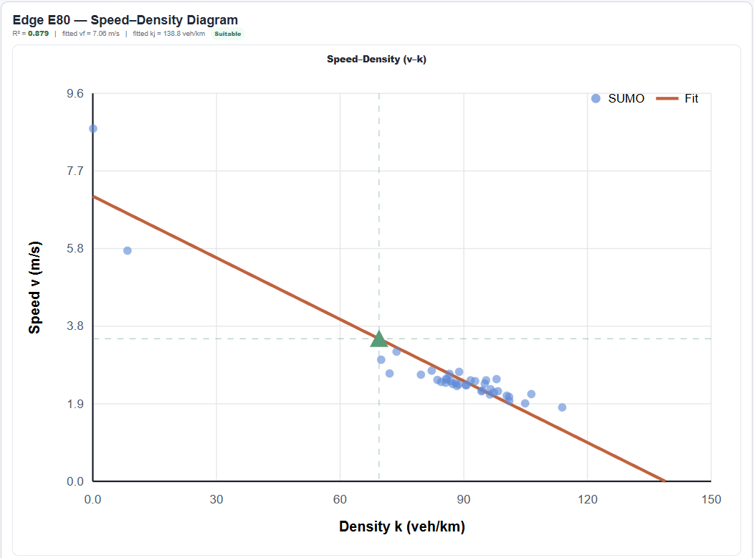
Base Scenario (HDV) vs. Scenario 2 (HDV, Intervention)
Base Scenario (HDV)
Scenario 2 (HDV, Intervention)

